Slide 1
Divide-and-Conquer Algorithms and Recurrence Relations
Section 8.3

Slide 2
Section Summary
Divide-and-Conquer Algorithms and Recurrence Relations
Examples
Binary Search
Merge Sort
Fast Multiplication of Integers
Master Theorem
Closest Pair of Points (not covered yet in these slides)

Slide 3
Divide-and-Conquer
The most-well known algorithm design strategy:
Divide instance of problem into two or more smaller instances
Solve smaller instances recursively
3. Conquer the solution to original (larger) instance by combining these solutions

Slide 4
Divide-and-Conquer (cont.)
a problem of size n
(instance)
subproblem 1
of size n/2
subproblem 2
of size n/2
a solution to
subproblem 1
a solution to
subproblem 2
It generally leads to a recursive algorithm!
a solution to
the original problem

Slide 5
Divide-and-Conquer Algorithmic Paradigm
Definition: A divide-and-conquer algorithm works by first dividing a problem into one or more instances of the same problem of smaller size and then conquering the problem using the solutions of the smaller problems to find a solution of the original problem.
Examples:
Binary search, covered in Chapters 3 and 5: It works by comparing the element to be located to the middle element. The original list is then split into two lists and the search continues recursively in the appropriate sublist.
Merge sort, covered in Chapter 5: A list is split into two approximately equal sized sublists, each recursively sorted by merge sort. Sorting is done by successively merging pairs of lists.

Slide 6
Divide-and-Conquer Recurrence Relations
Suppose that a recursive algorithm divides a problem of size n into a (a is a positive integer) subproblems.
Assume each subproblem is of size n/b. (b is a positive integer)
Suppose g(n) extra operations are needed in the conquer step.
Then f(n) represents the number of operations to solve a problem of size n satisfies the following recurrence relation:
f(n) = af(n/b) + g(n)
This is called a divide-and-conquer recurrence relation.

Slide 7
Example: Binary Search
Binary search reduces the search for an element in a sequence of size n to the search in a sequence of size n/2. Two comparisons are needed to implement this reduction;
one to decide whether to search the upper or lower half of the sequence and
the other to determine if the sequence has elements.
Hence, if f(n) is the number of comparisons required to search for an element in a sequence of size n, then
when n is even.
f(n) = f(n/2) + 2

Slide 8
Example: Merge Sort
The merge sort algorithm splits a list of n (assuming n is even) items to be sorted into two lists with n/2 items. It uses fewer than n comparisons to merge the two sorted lists.
Hence, the number of comparisons required to sort a sequence of size n, is no more than than M(n) where
M(n) = 2M(n/2) + n.

Slide 9
Example: Fast Multiplication of Integers
An algorithm for the fast multiplication of two 2n-bit integers (assuming n is even) first splits each of the 2n-bit integers into two blocks, each of n bits.
Suppose that a and b are integers with binary expansions of length 2n. Let
a = (a_{2n−1}a_{2n−2} … a₁a₀)₂ and b = (b_{2n−1}b_{2n−2} … b₁b₀)₂ .
Let a = 2^{n}A₁ + A₀, b = 2^{n}B₁ + B₀ , where
A₁ = (a_{2n−1} … a_{n+1}a_{n})₂ , A₀ = (a_{n−1} … a₁a₀)₂ ,
B₁ = (b_{2n−1} … b_{n+1}b_{n})₂ , B₀ = (b_{n−1} … b₁b₀)₂.
The algorithm is based on the fact that ab can be rewritten as:
ab = 2^{2n} A₁B₁ + 2^{n} (A₁ B₀ + A₀ B₁) + A₀B₀.
ab = (2^{2n} + 2^{n})A₁B₁ +2^{n} (A₁−A₀)(B₀ − B₁) +(2^{n} + 1)A₀B₀.
This identity shows that the multiplication of two 2n-bit integers can be carried out using three multiplications of n-bit integers, together with additions, subtractions, and shifts.
Hence, if f(n) is the total number of operations needed to multiply two n-bit integers, then
f(2n) = 3f(n) + Cn
where Cn represents the total number of bit operations; the additions, subtractions and shifts that are a constant multiple of n-bit operations.

Slide 10
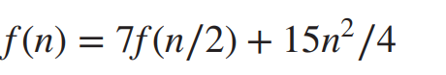
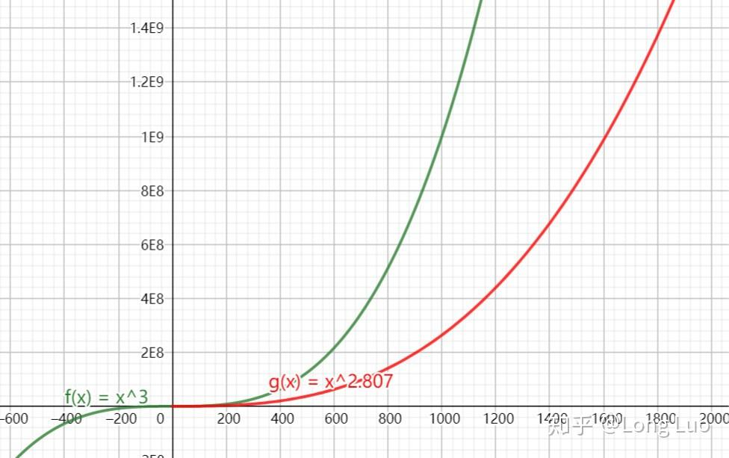
Example: Fast Matrix Multiplication
Strassen算法

Slide 11
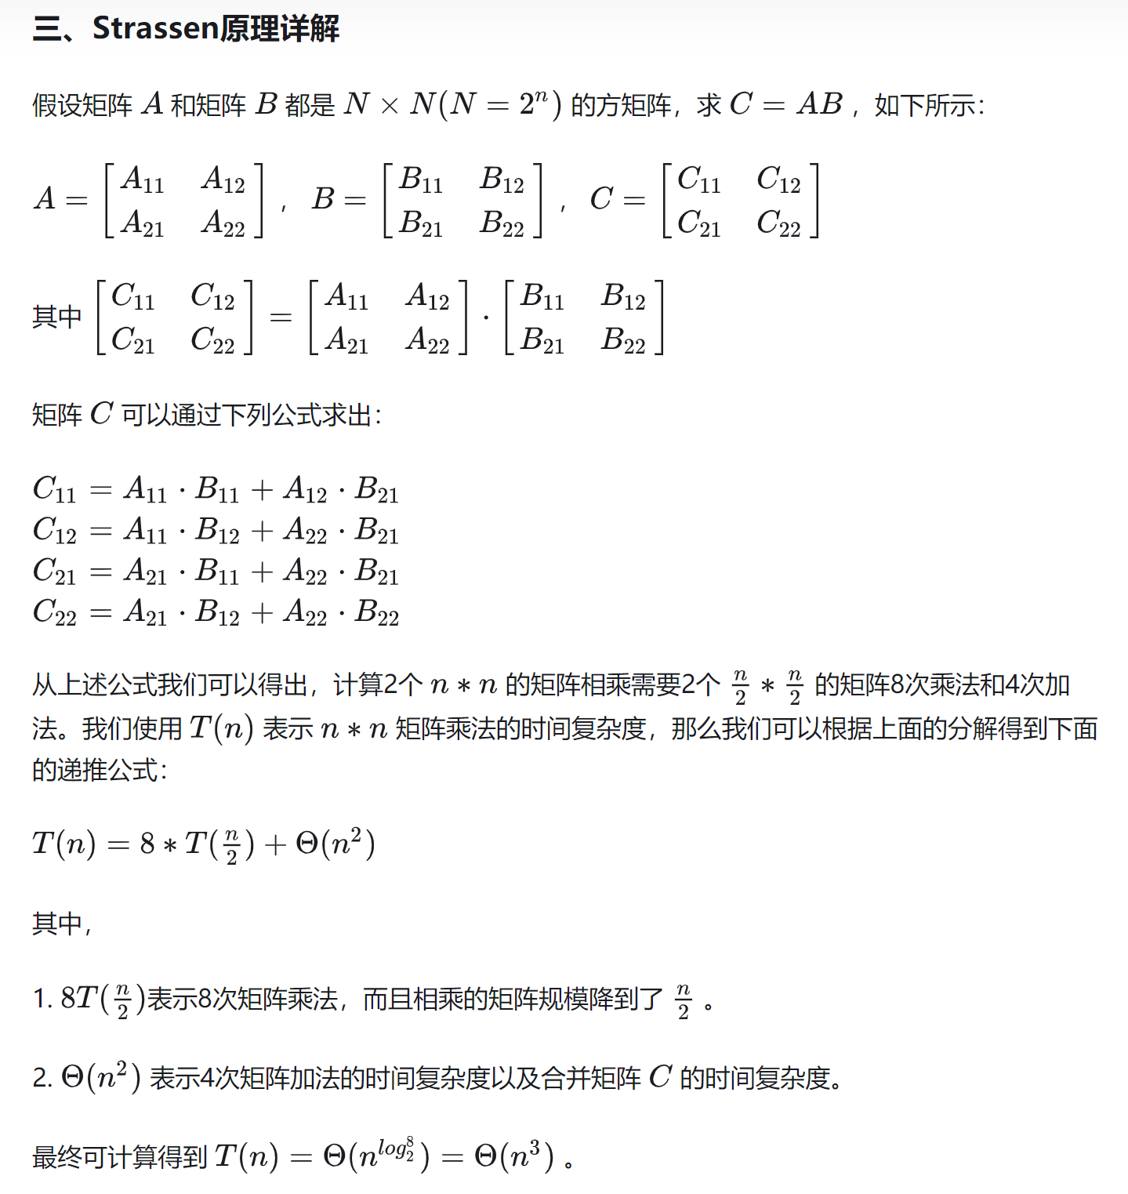
可以看出每次递归操作都需要8次矩阵相乘，而这正是瓶颈的来源。相比加法，矩阵乘法是非常慢的

Slide 12
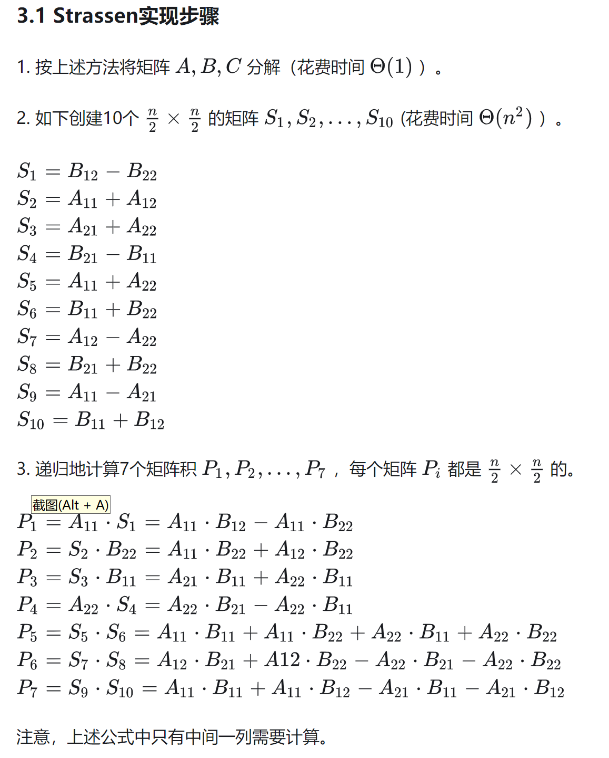
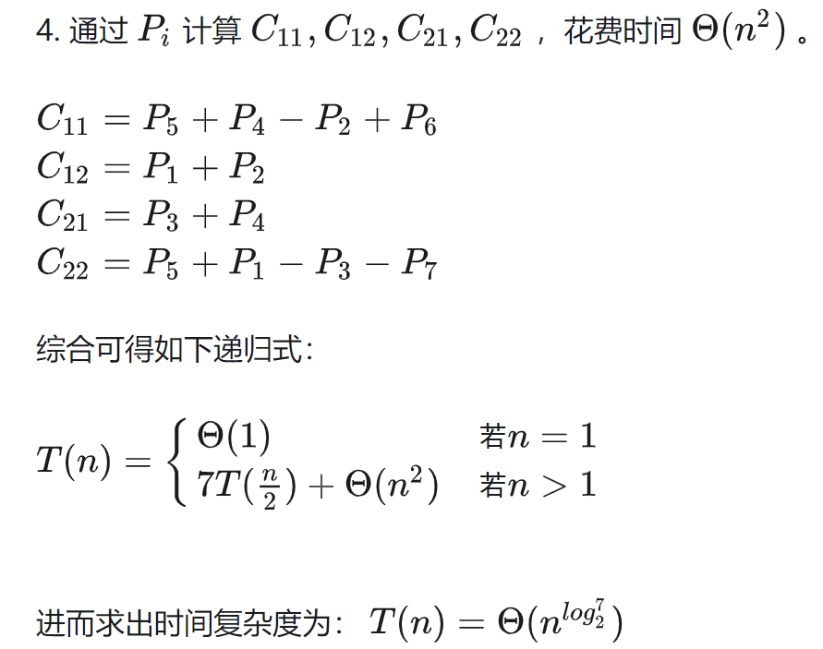

Slide 13
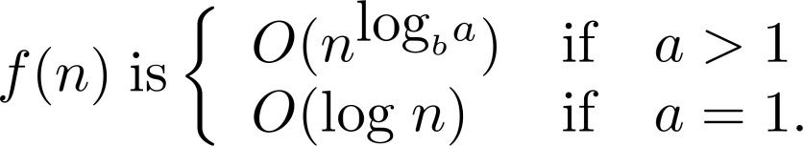
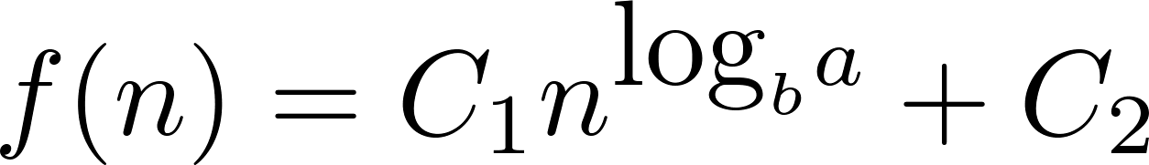
Estimating the Size of Divide-and-Conquer Functions
Theorem 1: Let f be an increasing function that satisfies the recurrence relation
f(n) = af(n/b) + c
whenever n is divisible by b, where a≥ 1, b is an integer greater than 1, and c is a positive real number. Then
Furthermore, when n = b^{k} and a ≠1, where k is a positive integer,
where C₁ = f(1) + c/(a−1) and C₁ = −c/(a−1).

Slide 14
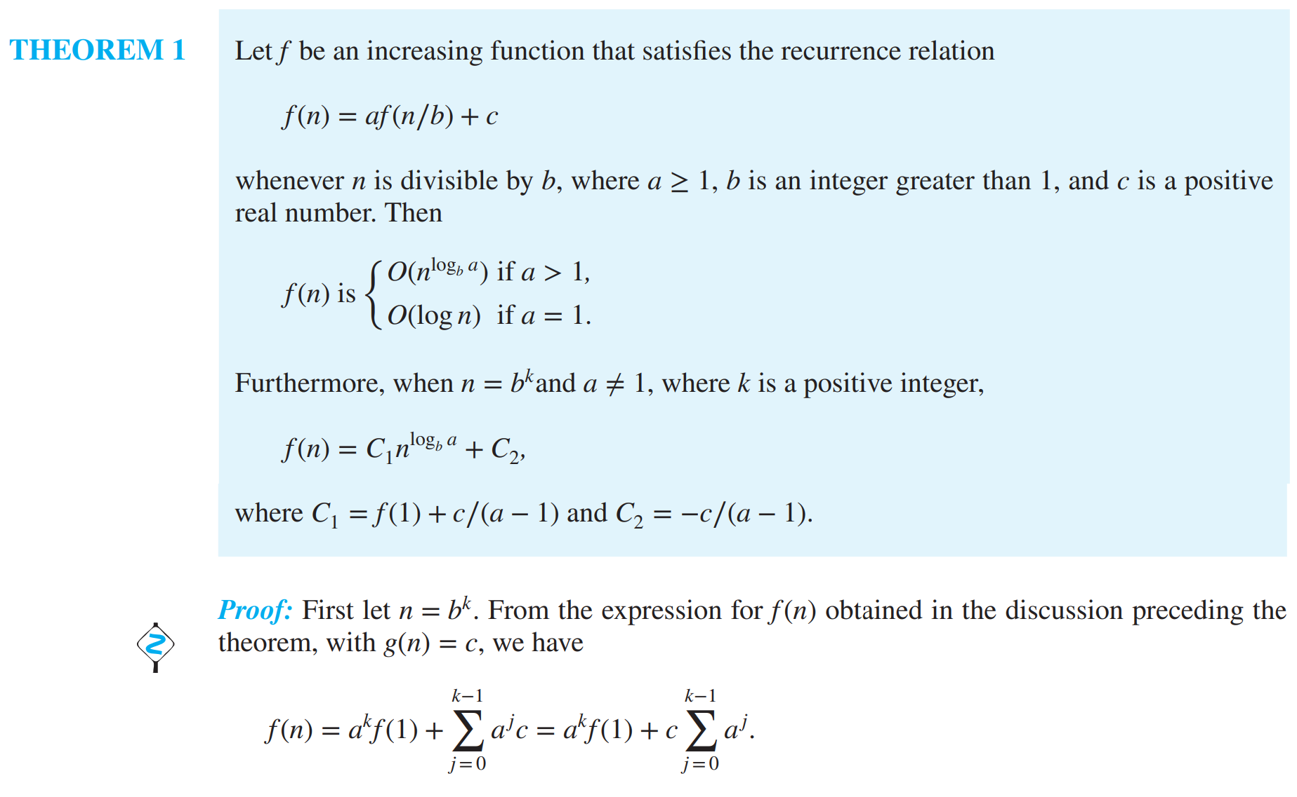
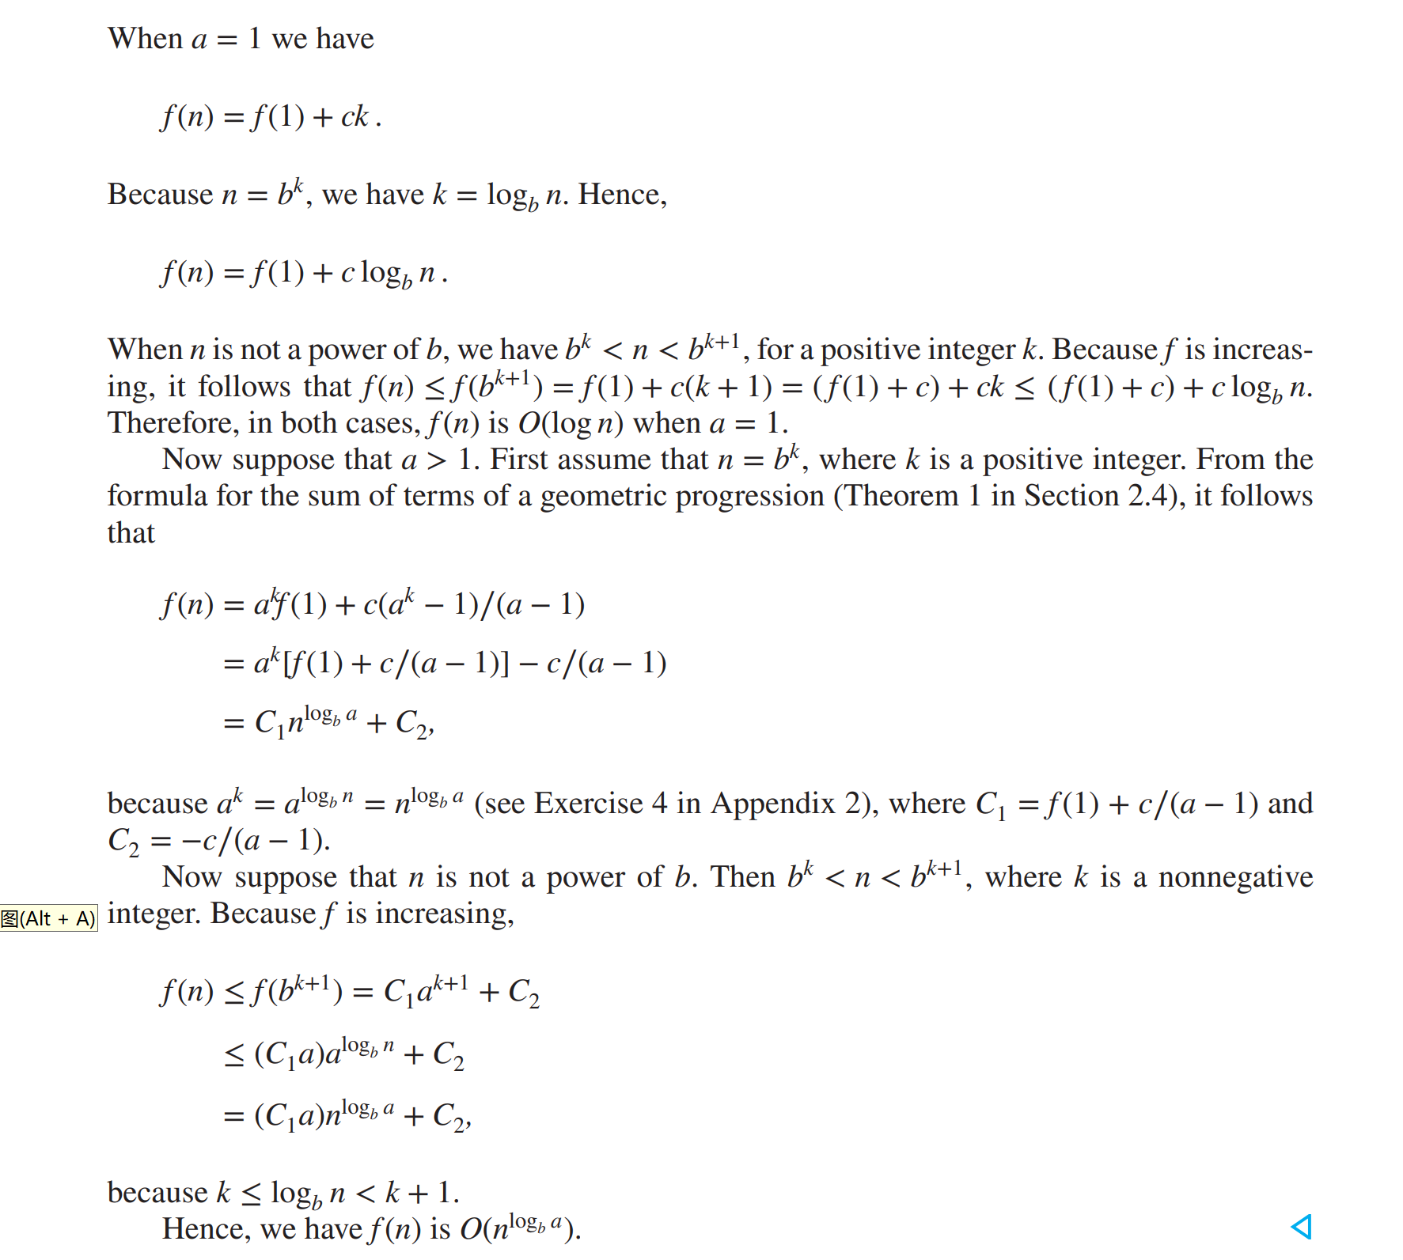

Slide 16
Complexity of Binary Search
Binary Search Example: Give a big-O estimate for the number of comparisons used by a binary search.
Solution: Since the number of comparisons used by binary search is
f(n) = f(n/2) + 2
where n is even, by Theorem 1, it follows that f(n) is O(log n).

Slide 17
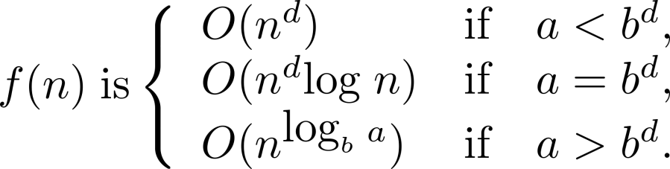
Estimating the Size of Divide-and-conquer Functions (continued)
Theorem 2. Master Theorem:
Let f be an increasing function that satisfies the recurrence relation
f(n) = af(n/b) + cn^{d}
whenever n = b^{k}, where a≥ 1, b is an integer greater than 1, k is a positive integer greater than 1, and c and d are real numbers with c positive and d nonnegative. Then

Slide 18
Complexity of Merge Sort
Merge Sort Example: Give a big-O estimate for the number of comparisons used by merge sort.
Solution: Since the number of comparisons used by merge sort to sort a list of n elements is less than M(n) where M(n) = 2M(n/2) + n, by the master theorem M(n) is O(n log n).

Slide 19
Complexity of Fast Integer Multiplication Algorithm
Integer Multiplication Example: Give a big-O estimate for the number of bit operations used needed to multiply two n-bit integers using the fast multiplication algorithm.
Solution: We have shown that f(n) = 3f(n/2) + Cn, when n is even, where f(n) is the number of bit operations needed to multiply two n-bit integers. Hence by the master theorem with a = 3, b = 2, c = C, and d = 1 (so that we have the case where a > b^{d}), it follows that f(n) is O(n^{log 3}).
Note that log 3 ≈ 1.6. Therefore the fast multiplication algorithm is a substantial improvement over the conventional algorithm that uses O(n²) bit operations.

Slide 20
Example: Fast Matrix Multiplication
Strassen算法

Slide 21
Homework
Sec. 8.3 22

